Slide 1

Block coding Developer
Session - 38
HTML Styles And Formatting

Slide 2

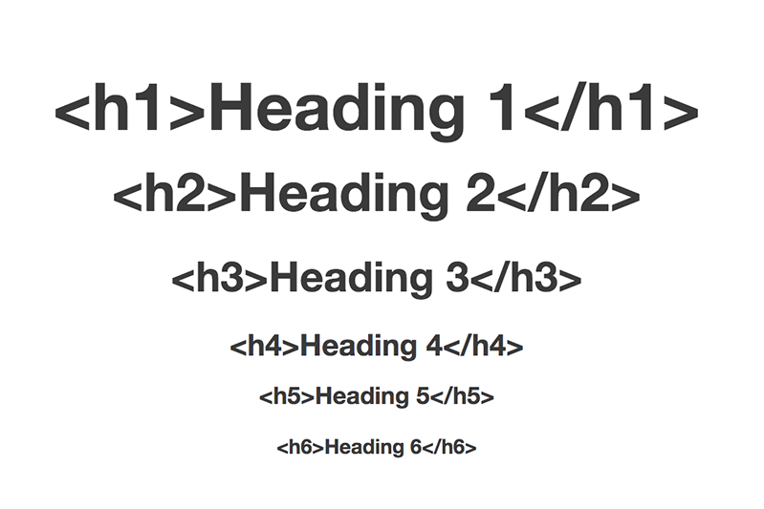
Recall…
What we have learnt in last session?
What challenges are you facing?

Slide 3
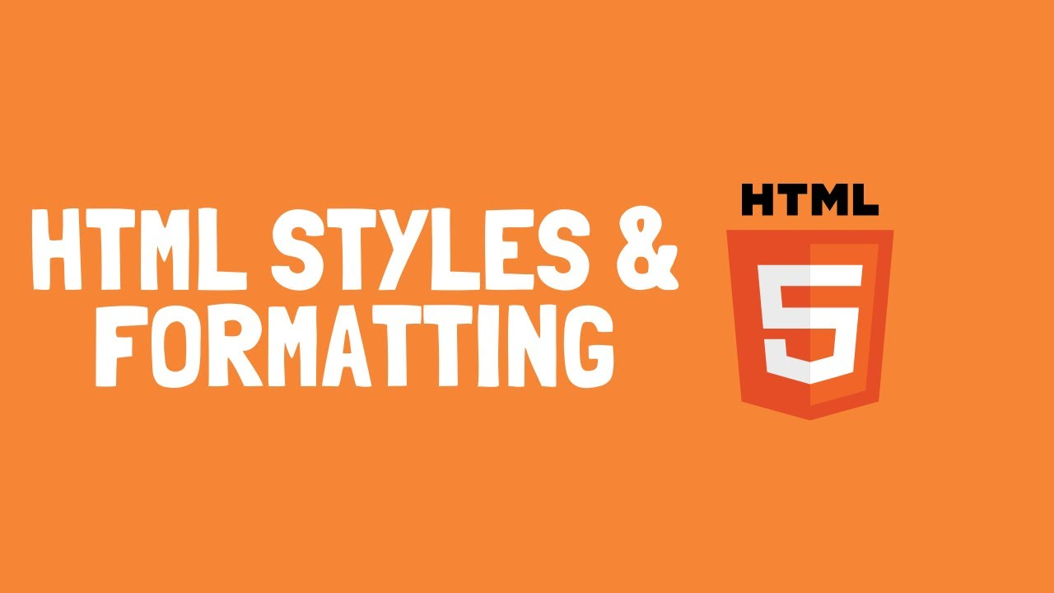
Style and formatting…
We will Learn today:
What is Style and formatting?
Background Colour in HTML
Text Colour in HTML
Font Family in HTML
Text Size in HTML
Text Alignment in HTML

Slide 4
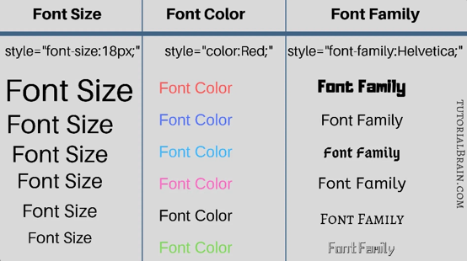
What is Style and formatting?
The HTML style attribute is used to add styles to an element, such as color, font, size, and more
The HTML style attribute has the following syntax:
<tagname style="property:value;">
Style

Slide 5
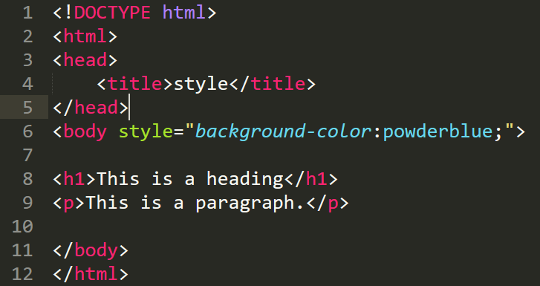
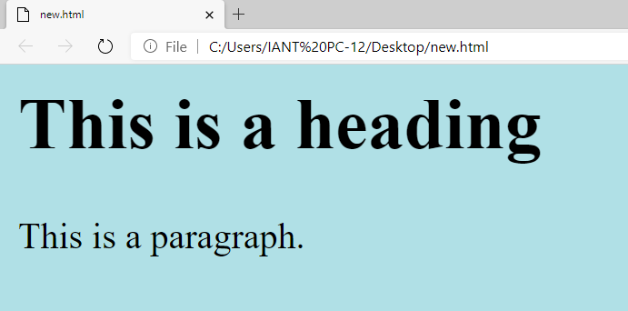
Defining Background Colour…

Slide 6
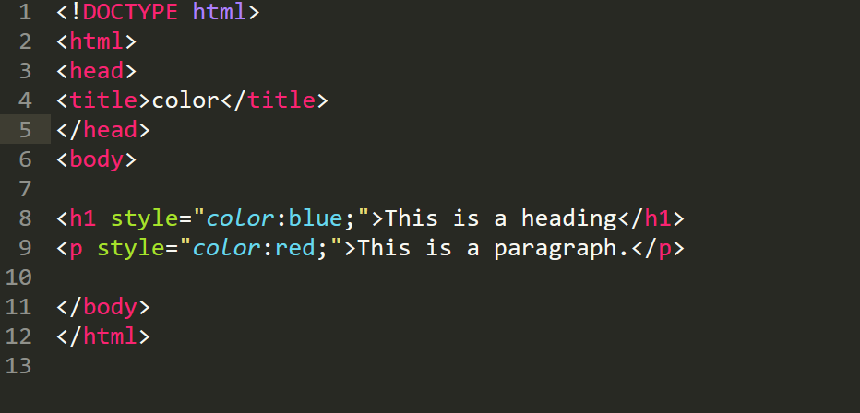
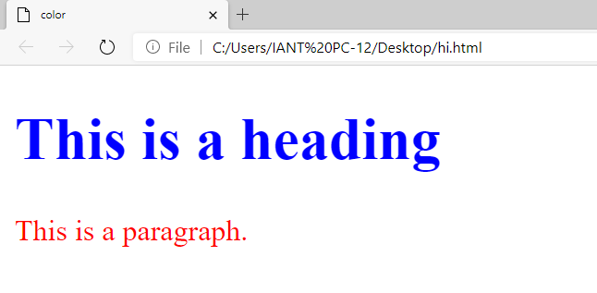
Defining Text Colour…

Slide 7
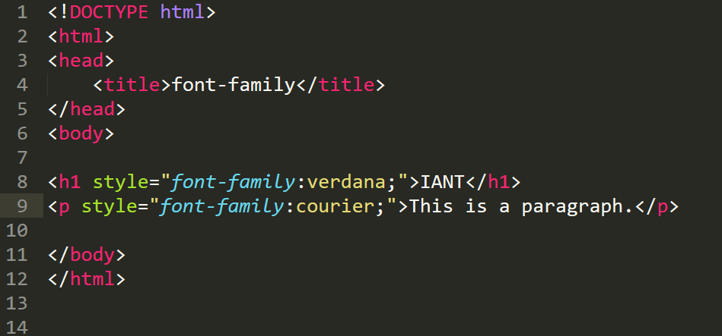
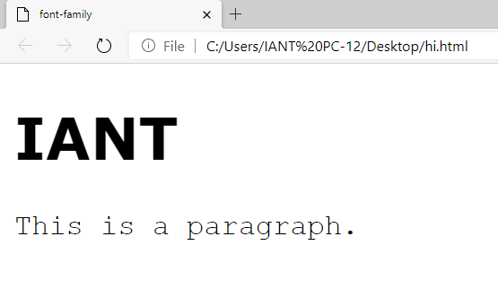
Defining Font To Be Used in HTML…

Slide 8
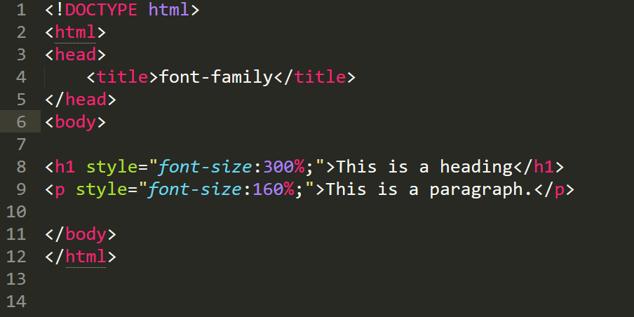
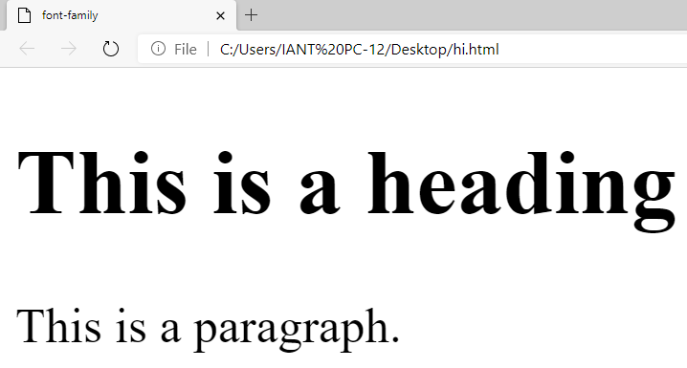
Defining Text Size…

Slide 9
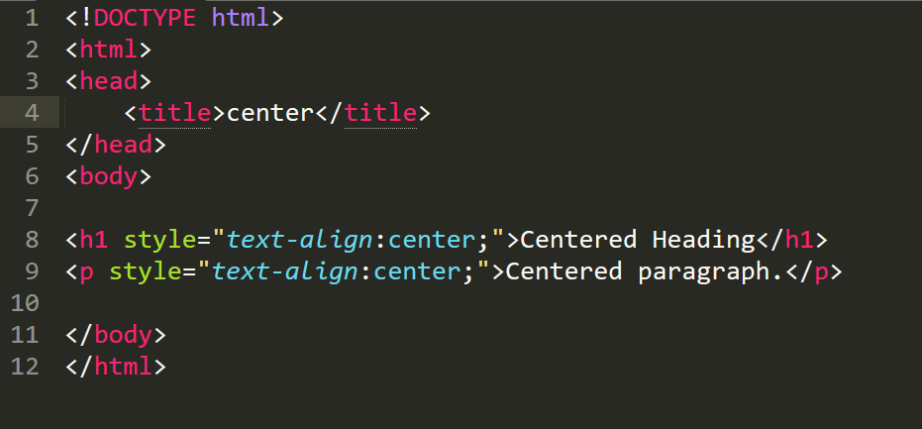
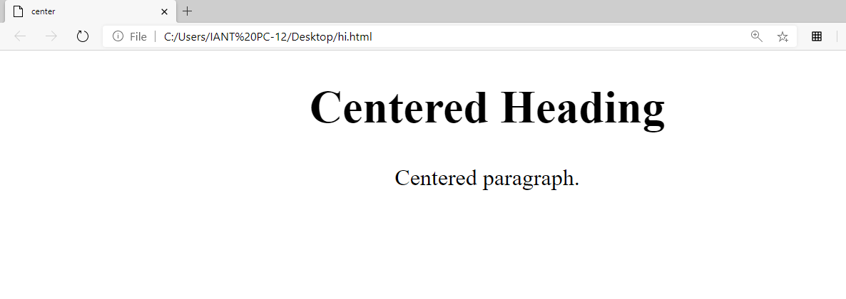
Defining Horizontal Text Alignment…

Slide 10
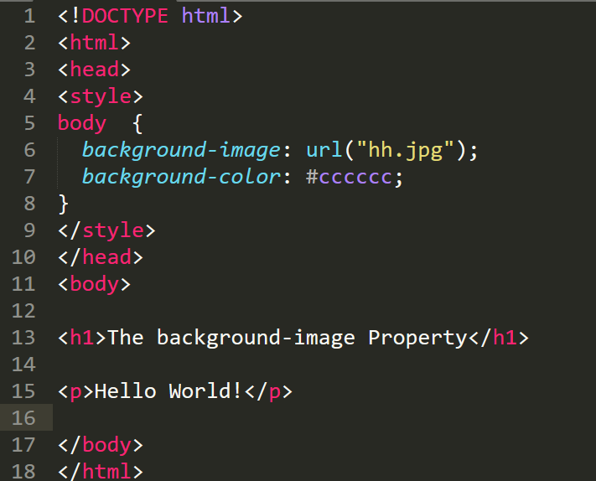
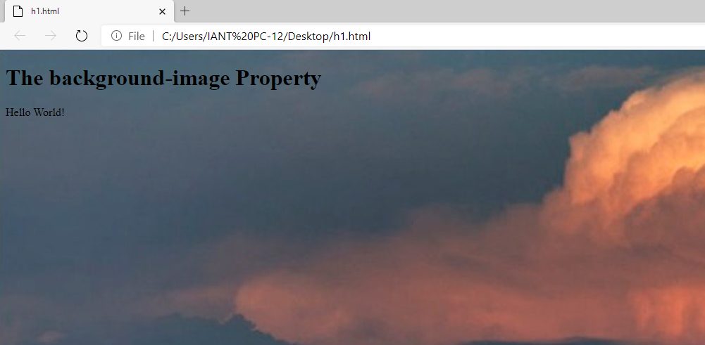
Background Image Property…

Slide 11
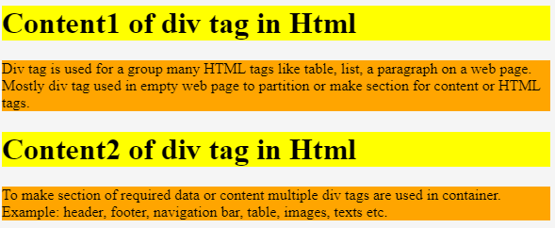
Grouping Content…
The <div> tag is used to group other HTML content together
It doesn't add or change the content of your HTML
To create a new <div>, we simply surround groups of HTML elements with an opening and closing <div> tag

Slide 12
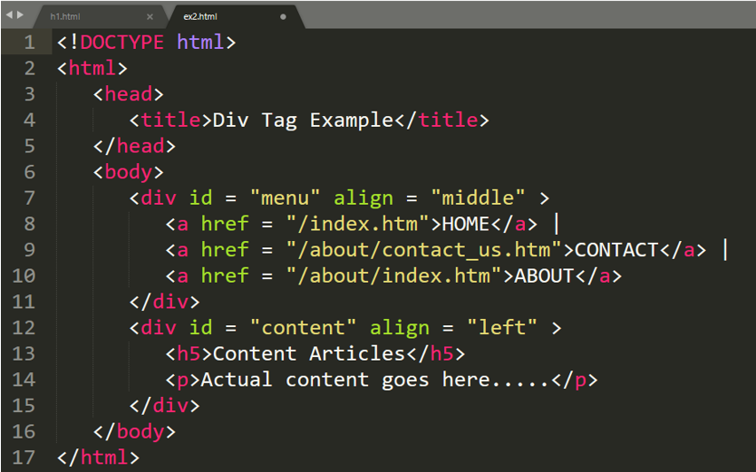
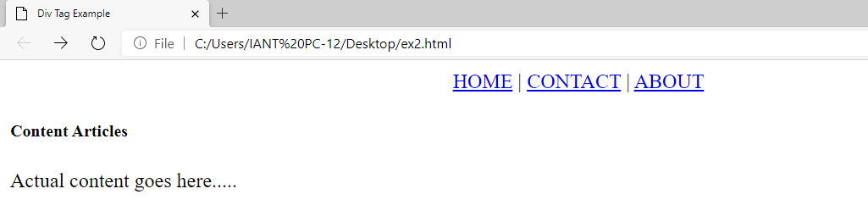
Example - Grouping Content…

Slide 13

Summary…
Style and formatting?
Background Colour in HTML
Text Colour in HTML
Font Family in HTML
Text Size in HTML
Text Alignment in HTML

Slide 14

Next Session…
What is CSS?
Types of CSS
What is Inline CSS?
What is Internal CSS?
What is External CSS?
CSS text alignment

